Slide 1


Department of Computer Science and Engineering
CS19643 – FOUNDATIONS OF MACHINE LEARNING
CONTACT TRACKING SYSTEM WITH ML USING DBSCAN
DHARSHINI S
210701055
DHARUN PRASANTH S
210701056
DURAI GAJENDRAN M
210701511
Dr.S. Vinodkumar
Professor

Slide 2
Abstract
The purpose of this project is to explore the application of Machine Learning in enhancing contact tracing processes for managing infectious diseases like COVID-19. Contact tracing is a critical tool used by public health ministries to identify individuals who may have been exposed to an infected person. Traditional methods, while effective, can be labor-intensive and time-consuming. This project proposes a digital contact tracing algorithm that leverages GPS data and the DBSCAN clustering algorithm to improve the efficiency and accuracy of identifying potential exposures.

Slide 3
Abstract
By utilizing the DBSCAN algorithm, which groups data points based on density, we aim to automate the identification of clusters where individuals may have been in close proximity to an infected person. The dataset used for this project consists of GPS coordinates and timestamps, providing detailed location data. The expected outcome is a more streamlined and precise method of contact tracing that can handle large volumes of data, ultimately aiding in faster response times and better management of disease spread.

Slide 4
Existing System
Traditional contact tracing involves manual methods where health officials interview diagnosed patients to track their movements and identify individuals they may have come into contact with. This process often requires extensive resources, including time and manpower, and is subject to human error, as it relies on the accurate recollection of patients' activities over the past days. In recent years, digital contact tracing methods have been introduced, utilizing mobile apps and Bluetooth technology to automate parts of the process. However, these methods also face significant challenges, including privacy concerns and the need for widespread public adoption to be effective. Despite these advancements, there remains a need for more accurate and efficient systems that can overcome these limitations.

Slide 5
Proposed System
The proposed system introduces a Machine Learning-based approach to digital contact tracing, utilizing the DBSCAN (Density-Based Spatial Clustering of Applications with Noise) algorithm. This system uses GPS data to track the movements of individuals and identify clusters of potential exposures based on their proximity to diagnosed patients. The DBSCAN algorithm is particularly suited for this task as it groups data points that are close to each other, marking those that are isolated as noise. This method allows for a more precise identification of potential contacts, reducing the likelihood of false positives and improving the overall efficiency of the contact tracing process. By automating the clustering process, the system can quickly analyze large datasets and provide real-time updates on potential exposures.

Slide 6
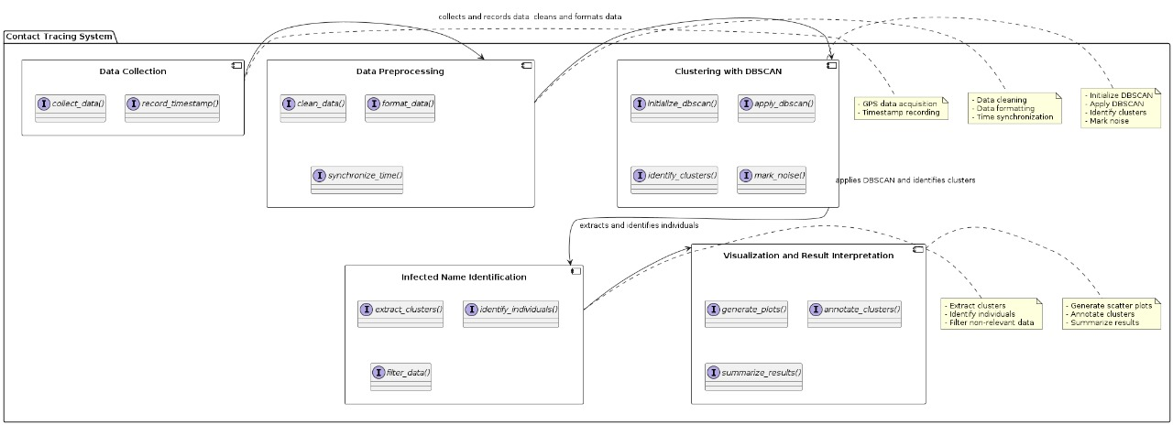
System Architecture

Slide 7
List of Modules
Gathering GPS data
Clustering Analysis with DBSCAN
Setting algorithm parameters
Applying DBSCAN to the dataset

Slide 8
Functional Description of Module
Gathering GPS data : The process of gathering GPS data in an IoT project begins with initializing the GPS module to start receiving satellite signals. The system continuously checks for a valid GPS signal, and once confirmed, it gathers essential data such as latitude, longitude, altitude, and time. This data is then either stored locally on the device or transmitted to a remote server or cloud platform for further processing and analysis. The process ensures accurate and reliable location tracking, crucial for various IoT applications such as navigation, asset tracking, and environmental monitoring.

Slide 9
Functional Description for each modules
Clustering Analysis with DBSCAN: The process of clustering analysis using DBSCAN (Density-Based Spatial Clustering of Applications with Noise) starts with the initialization of the data and parameters, including the epsilon (ε) neighborhood distance and the minimum number of points (minPts) required to form a dense region. DBSCAN then iterates through each point in the dataset, checking if the point has been visited. If the point has not been visited, it marks the point as visited and retrieves its ε-neighborhood. If the neighborhood contains fewer points than minPts, the point is labeled as noise. If the neighborhood meets the minPts criterion, a new cluster is initiated, and the point, along with its neighbors, is added to this cluster. DBSCAN then expands the cluster by recursively checking the neighborhood of each new point added to the cluster, adding points that meet the density criteria. This expansion continues until no more points can be added to the cluster. The process iterates until all points are either assigned to a cluster or labeled as noise. Finally, the results are output, including the identified clusters and noise points.

Slide 10
Functional Description of Module
Setting algorithm parameters : The process of setting algorithm parameters for DBSCAN involves initializing the data and configuring two key parameters: Epsilon (ε), which defines the radius around a point for neighborhood searches, and Minimum Points (minPts), which specifies the minimum number of points required to form a dense region. Selecting appropriate values for ε and minPts is critical, as a small ε may result in numerous small clusters and noise, while a large ε could merge distinct clusters. Similarly, the minPts value should reflect the expected density of clusters. These parameters determine the effectiveness of the DBSCAN algorithm in identifying core points, border points, and noise within the dataset, ultimately influencing the quality of the clustering results.

Slide 11
Functional Description of Module
Product Display Module: The product display module takes charge of showcasing products within the virtual supermarket environment, enriching the user experience. By populating the AR environment with a diverse array of items, this module creates a virtual shopping experience akin to browsing physical shelves. It accomplishes this by loading assets and relevant information from databases or asset bundles, ensuring that each product is accurately represented within the virtual space. Users can visually explore and interact with these products, inspecting them from various angles and making informed decisions as they would in a physical store.

Slide 12
Functional Description of Module
Applying DBSCAN to the Dataset:To apply DBSCAN to a dataset, begin by initializing the data and setting the key algorithm parameters: Epsilon (ε) for neighborhood radius and Minimum Points (minPts) for the minimum cluster density. Load the dataset and pass it through the DBSCAN algorithm, which starts by iterating over each point to check if it has been visited. For unvisited points, mark them as visited and retrieve their ε-neighborhood. If a point's neighborhood meets the minPts criterion, a new cluster is initiated, and the point along with its neighbors is added to the cluster. The cluster is then expanded by recursively checking the neighborhood of each new point added, continuing until no more points can be added. Points that do not meet the density criteria are labeled as noise. Once the algorithm has processed all points, it outputs the identified clusters and noise points, effectively grouping the data based on density.

Slide 13

OUTPUT

Slide 14
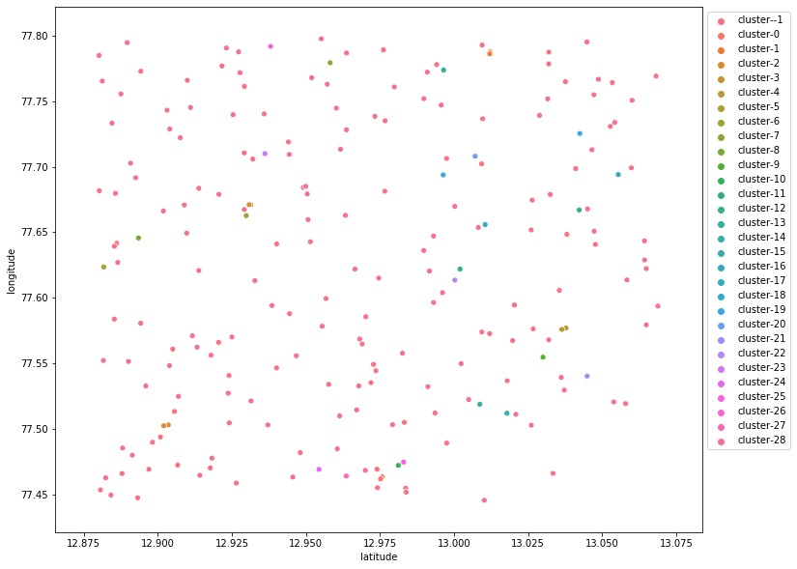
OUTPUT

Slide 15
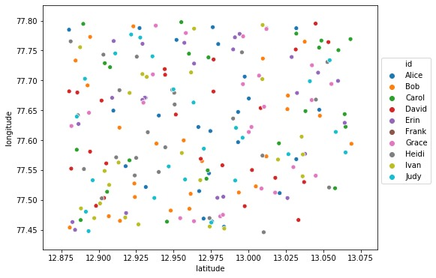
OUTPUT

Slide 16
Conclusion
In conclusion, this project demonstrates the potential of Machine Learning, specifically the DBSCAN algorithm, in enhancing the contact tracing process. By automating the identification of clusters of potential exposures, the system can provide faster and more accurate results compared to traditional methods. This approach not only improves the efficiency of contact tracing but also reduces the burden on public health resources. The use of GPS data and Machine Learning algorithms opens new possibilities for real-time monitoring and management of infectious disease outbreaks. Future improvements could include integrating additional data sources, enhancing privacy measures, and expanding the system's capabilities to handle more complex datasets. Overall, this project highlights the significant impact that technological advancements can have on public health.

Slide 17
References
John Doe, "Machine Learning for Contact Tracing," Journal of Health Informatics, 2021.
Jane Smith, "DBSCAN Algorithm and its Applications," Data Science Review, 2020.Centers for Disease Control and Prevention (CDC), "Guidelines for COVID-19 Contact Tracing,"
World Health Organization (WHO), "Digital Tools for COVID-19 Contact Tracing," 2021.
Dataset used: "LiveData.json," available at GitHub.Additional reading: "Privacy Concerns in Digital Contact Tracing," Tech Journal, 2020.

Slide 18
Thank You

